Slide 1

DELTA

Slide 2
IDEA STATEMENT
Finding accommodation is a major challenge for students joining a new college. To address this issue, we have developed a website that brings together all available housing options in one place, making it easier for students to find and choose the best option for their needs.

Slide 3
TEAM MEMBER DETAILS
Team Member Name | Phone Number | Email ID
Anitta Davis Mundassery | 7034278166 | anittamundassery@gmail.com
Archana Sekhar | 6282606092 | archanasekhar07@gmail.com
Eza Mariyam Robin | 8086160043 | ezamariyam1610@gmail.com
Sandra Anna Biju | 9778142668 | sandrachackalayil05@gmail.com

Slide 4
HEIM
A user-friendly website providing detailed information on hostels and PG accommodations near Govt. Model Engineering College.
KEY FEATURES
Search functionality for easy accommodation discovery
Filter options (PG/Hostel, Boys/Girls) for tailored results
Accommodation details displayed in card format (price, address, contact)
Option for users to add and update new accommodation information. Additionally, we have included delete option.

Slide 5
METHODOLOGIES USED
Front End : React
Back End : Java Spring Boot
Database : MySQL

Slide 6
TOTAL EXPENDITURE :
NIL

Slide 7
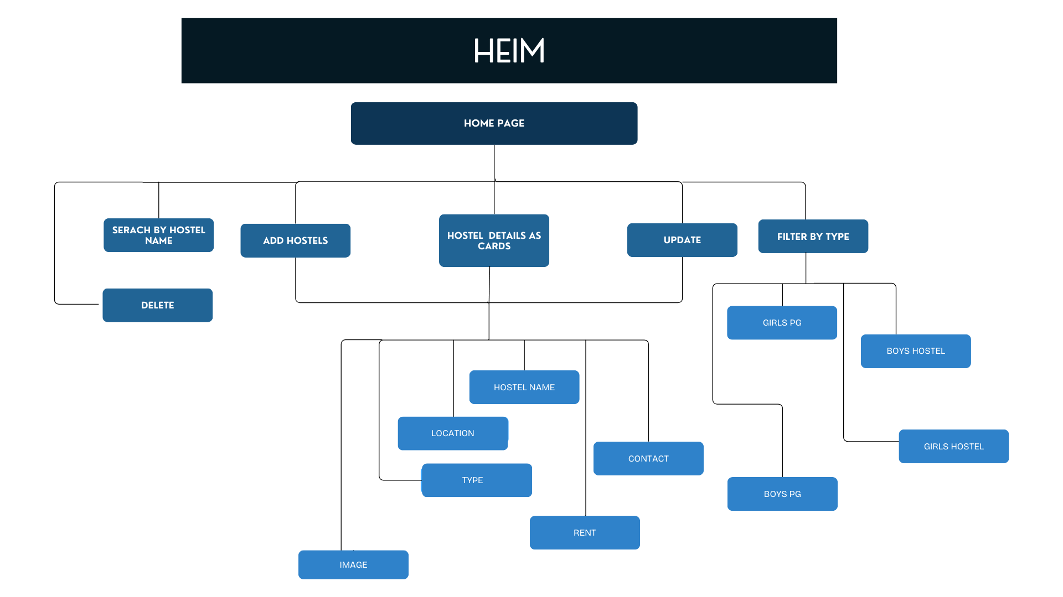
CIRCUIT DIAGRAM/ SCHEMATIC DIAGRAM

Slide 8
CODE FILES

Slide 9
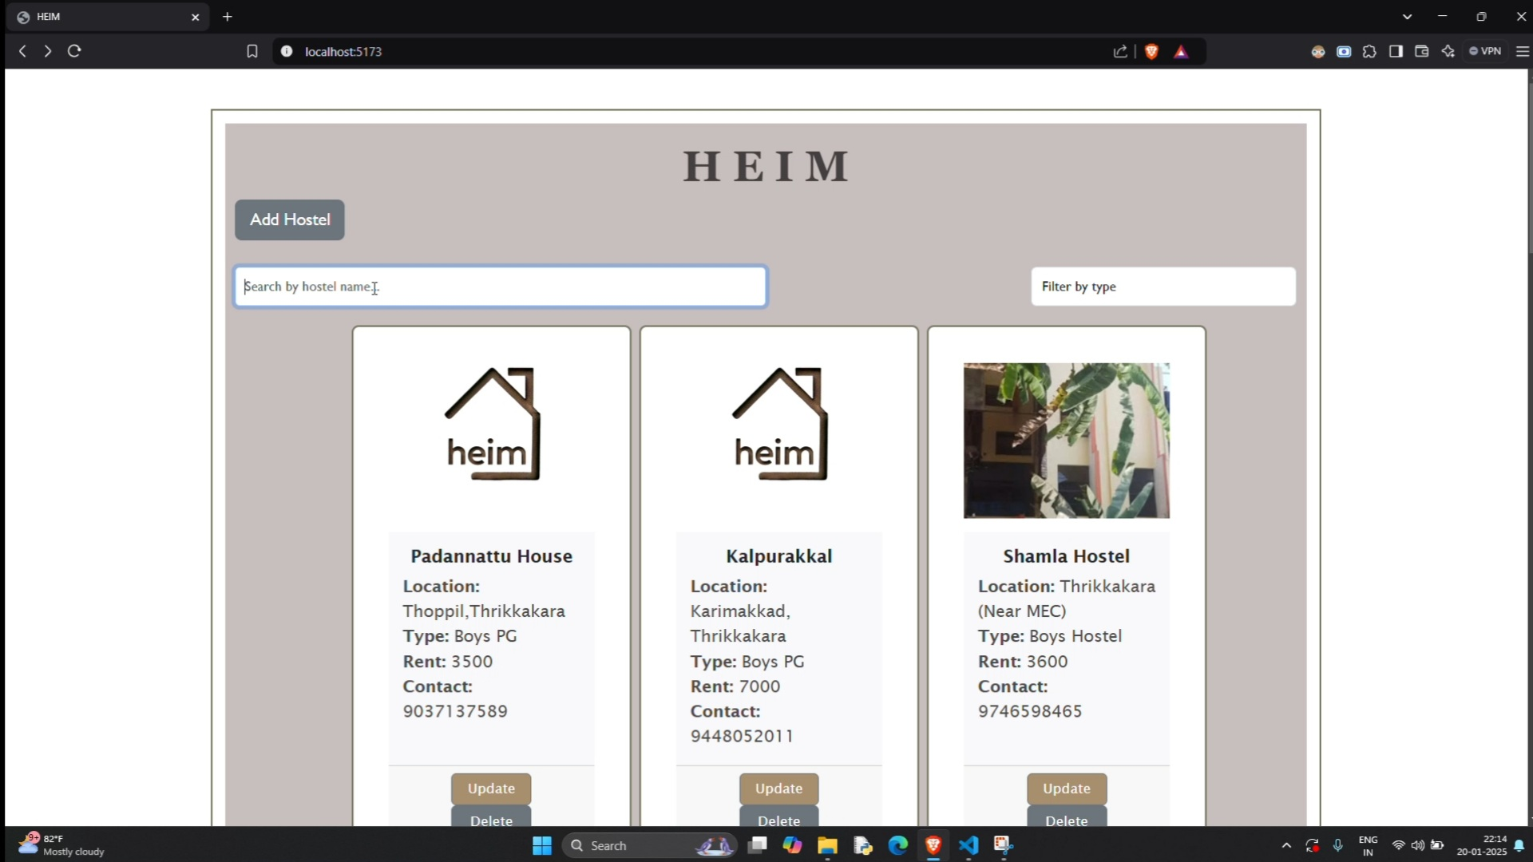
IMAGES

Slide 10
THANK YOU!

